Slide 1
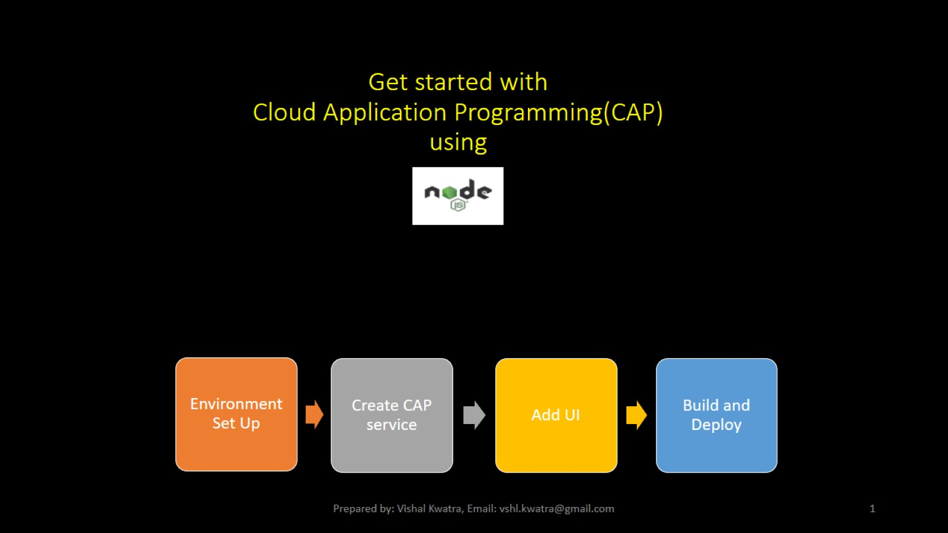
Get started with Cloud Application Programming(CAP) using

Slide 2
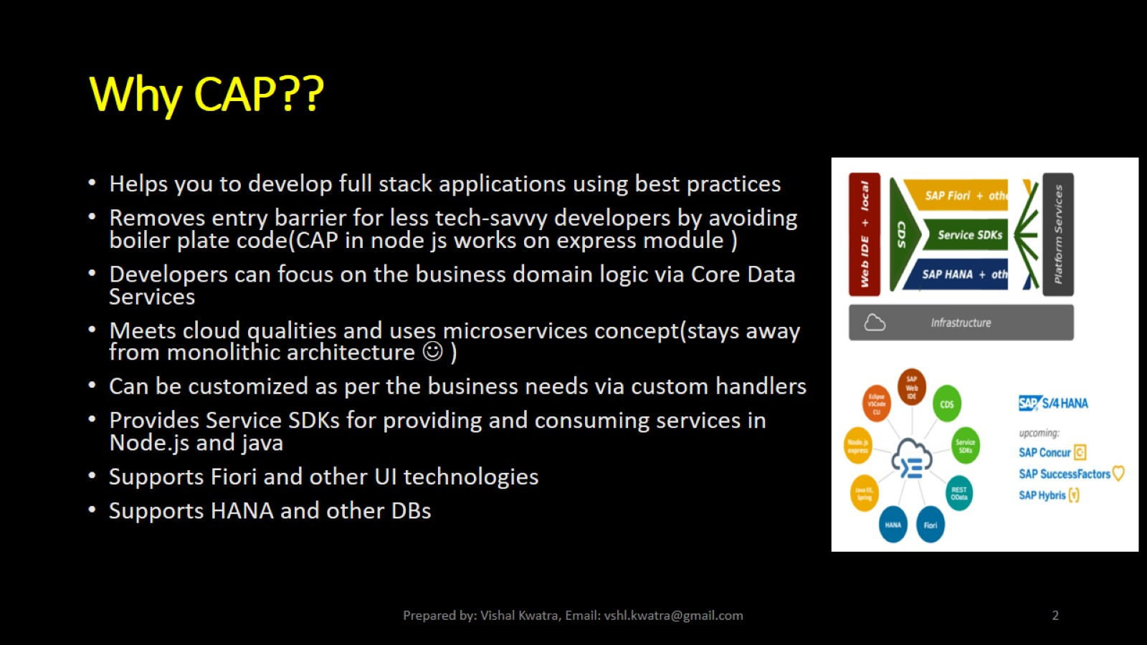
Why CAP??

Slide 3
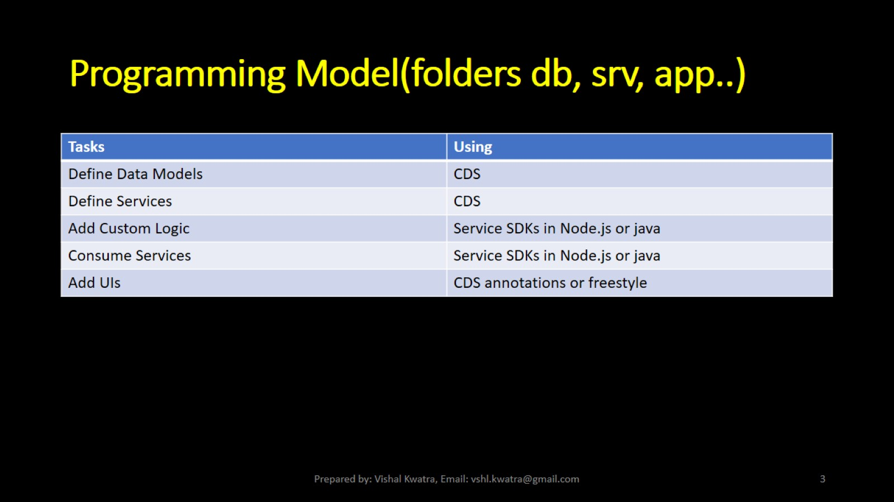
Programming Model(folders db, srv, app..)

Slide 4
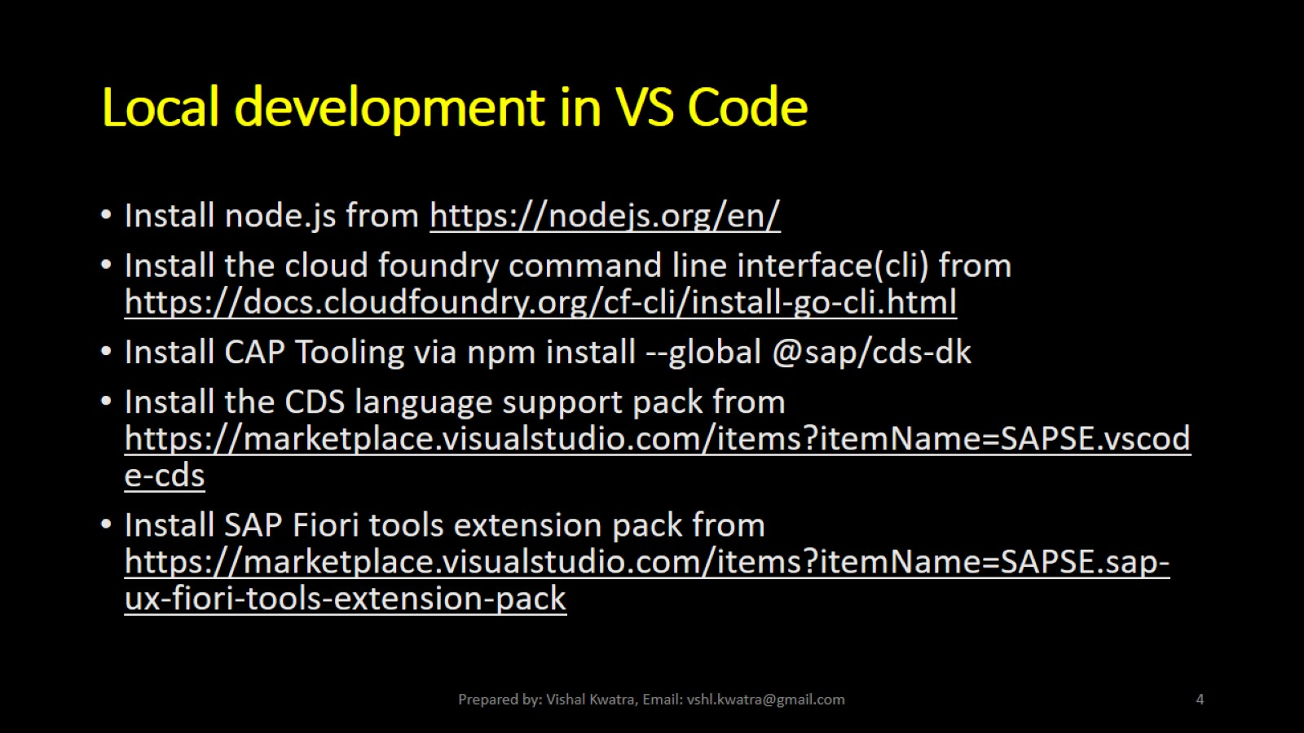
Local development in VS Code

Slide 5
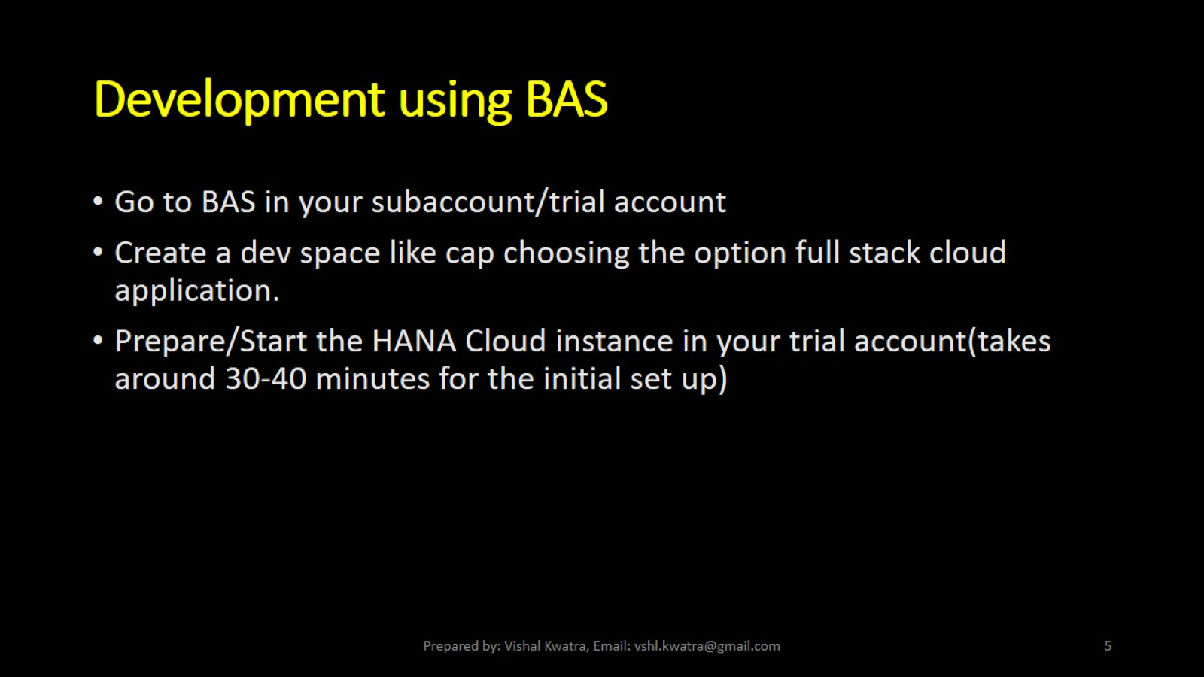
Development using BAS

Slide 6
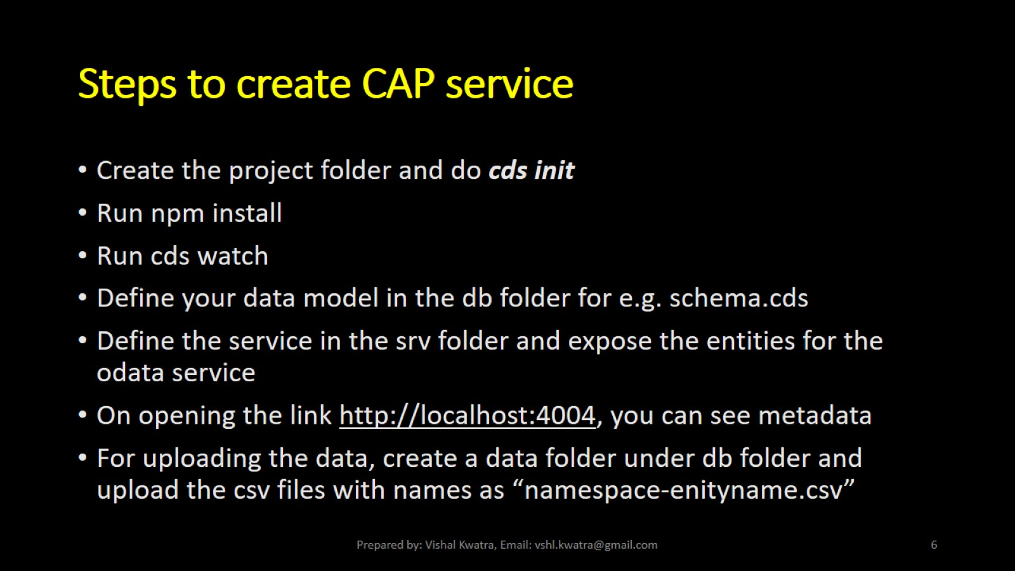
Steps to create CAP service

Slide 7
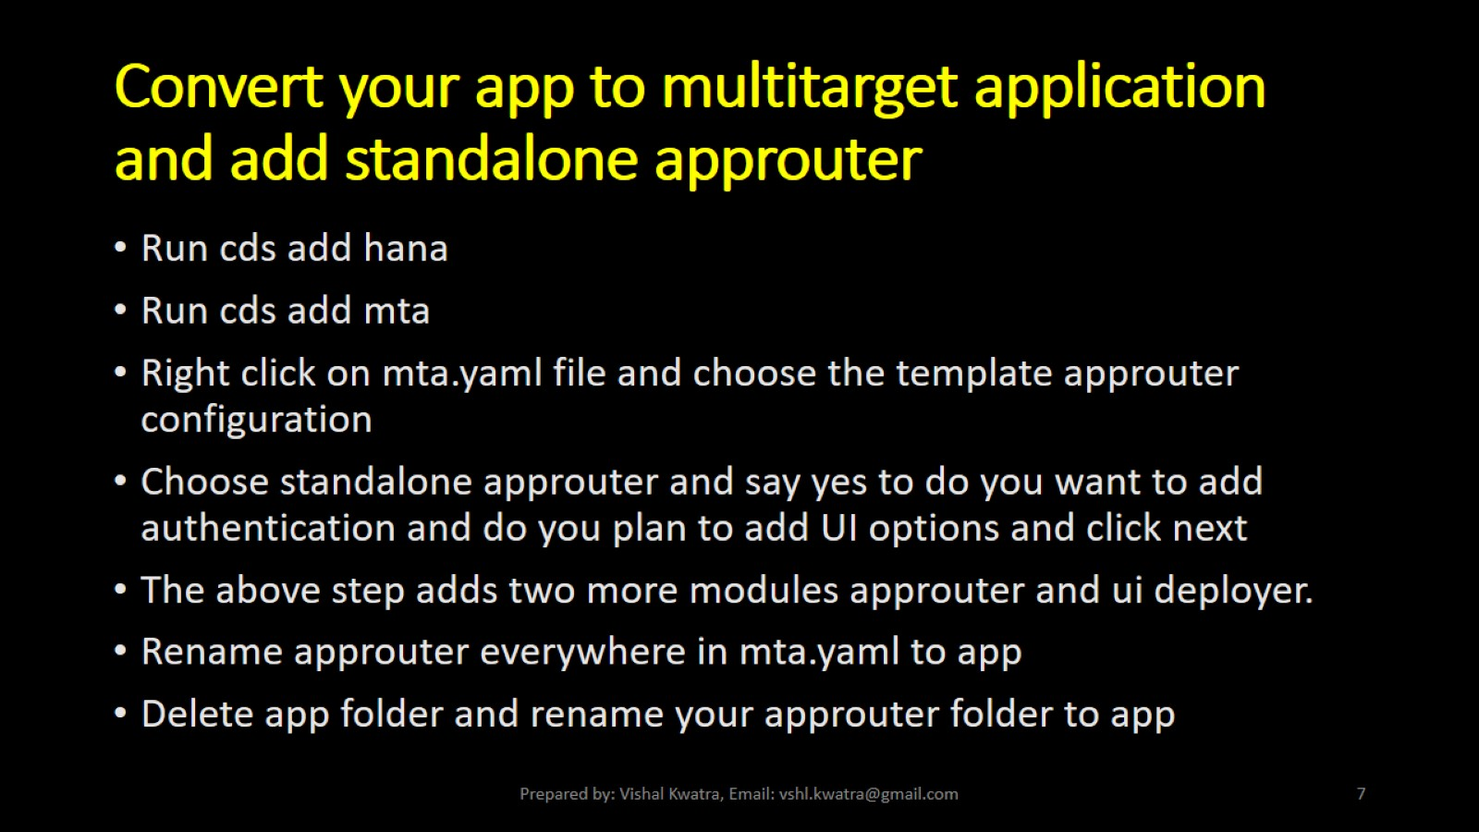
Convert your app to multitarget application and add standalone approuter

Slide 8
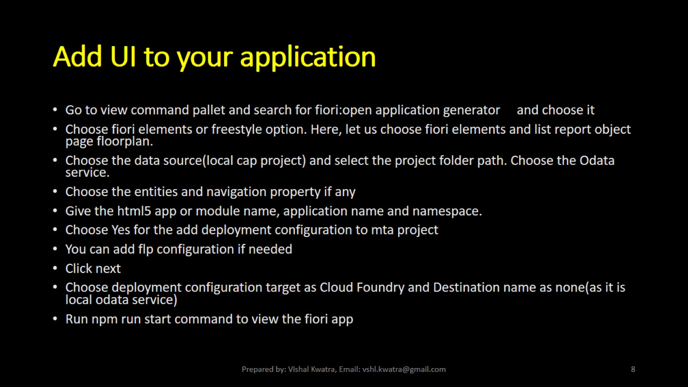
Add UI to your application

Slide 9
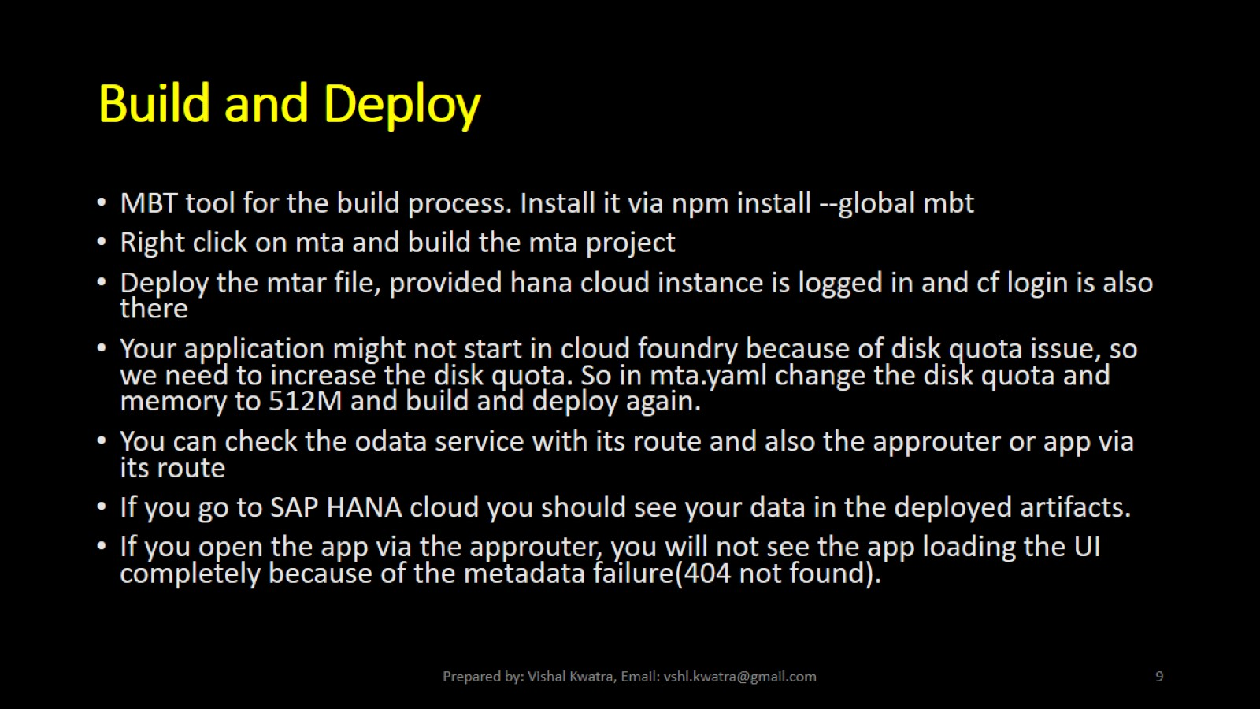
Build and Deploy

Slide 10
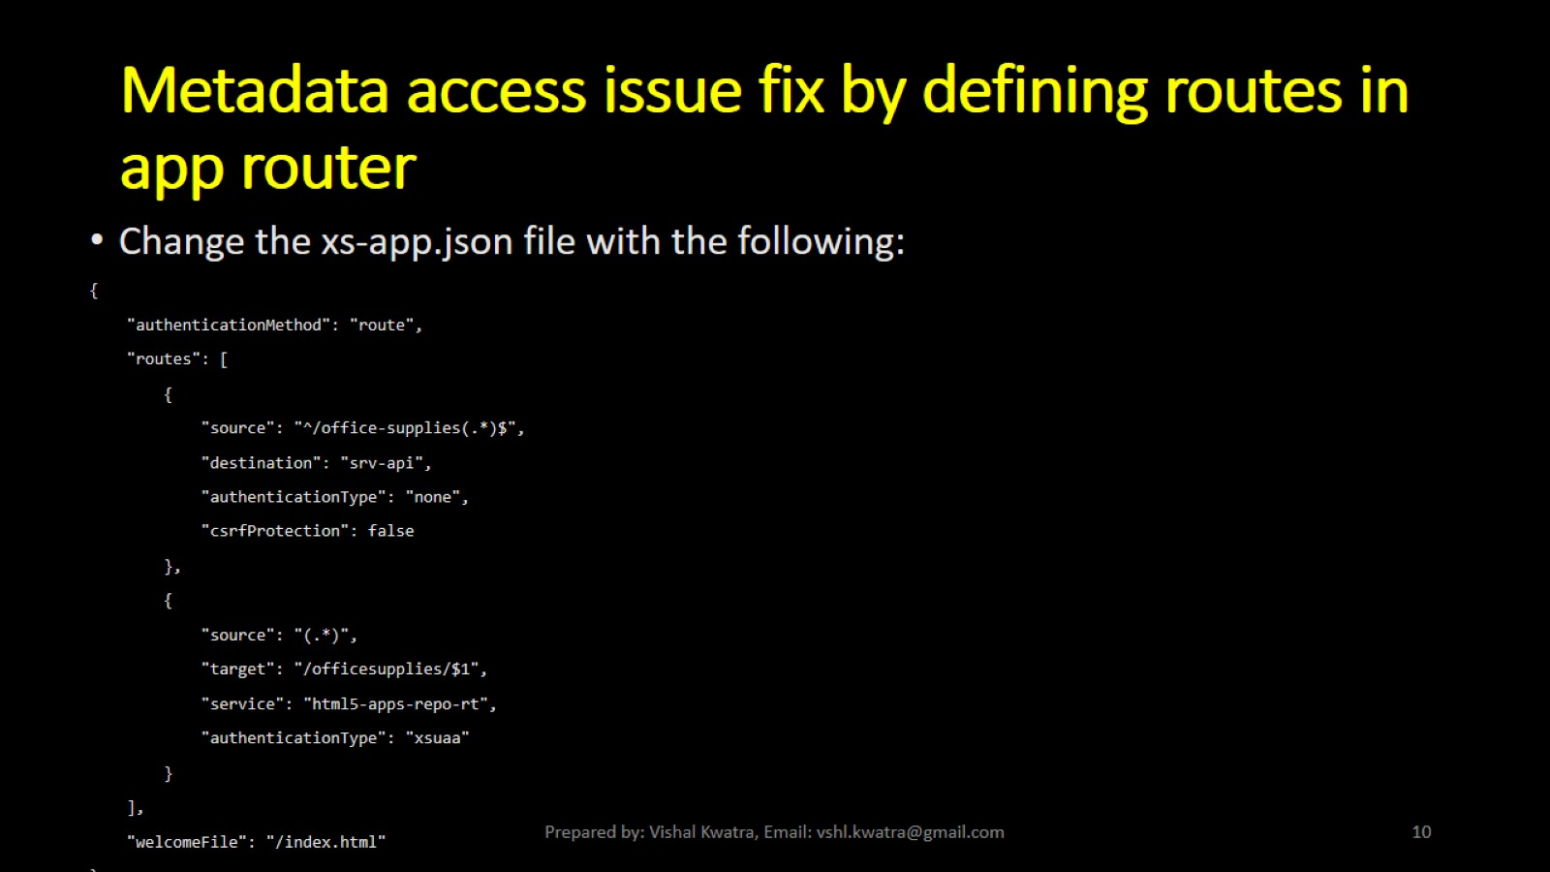
Metadata access issue fix by defining routes in app router

Slide 11
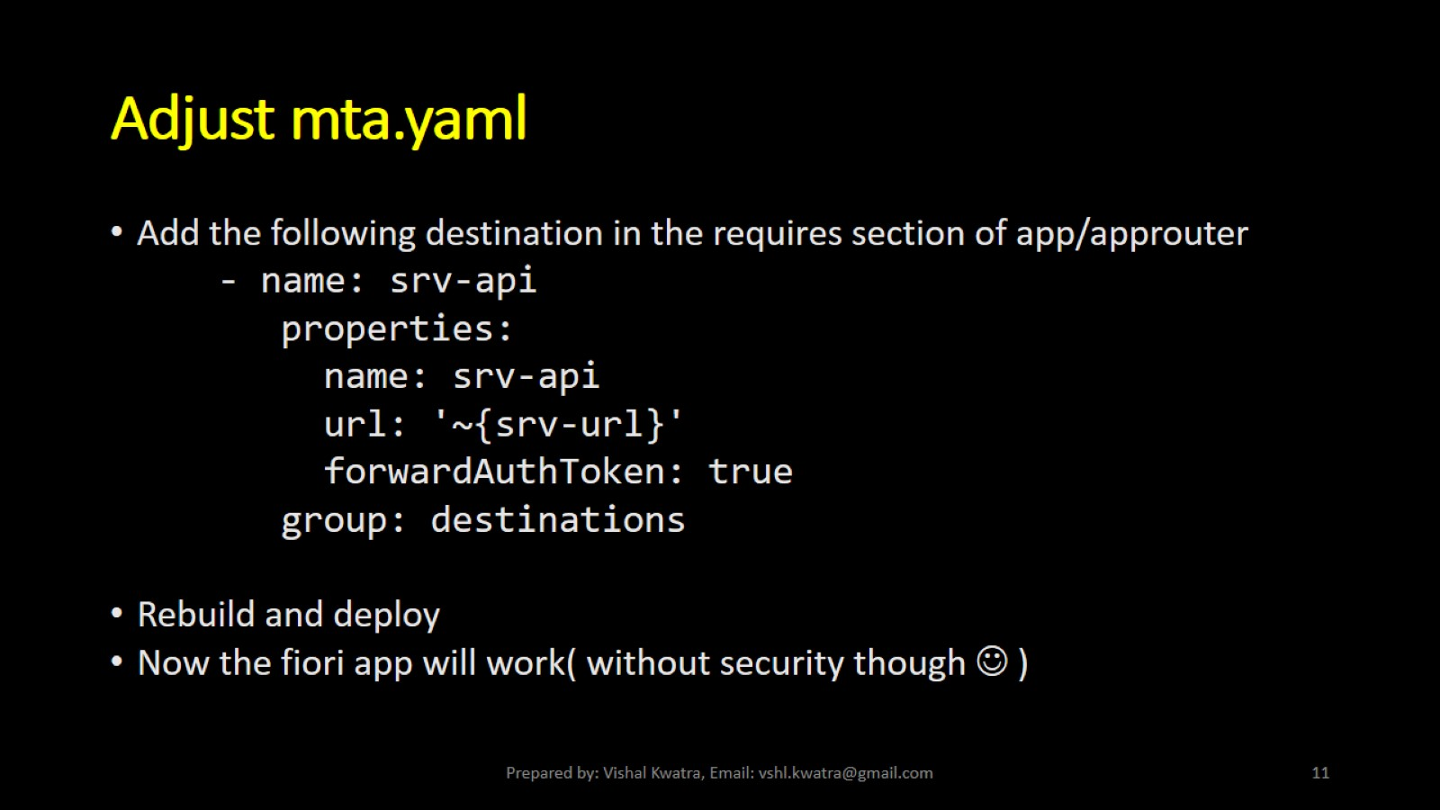
Adjust mta.yaml

Slide 12
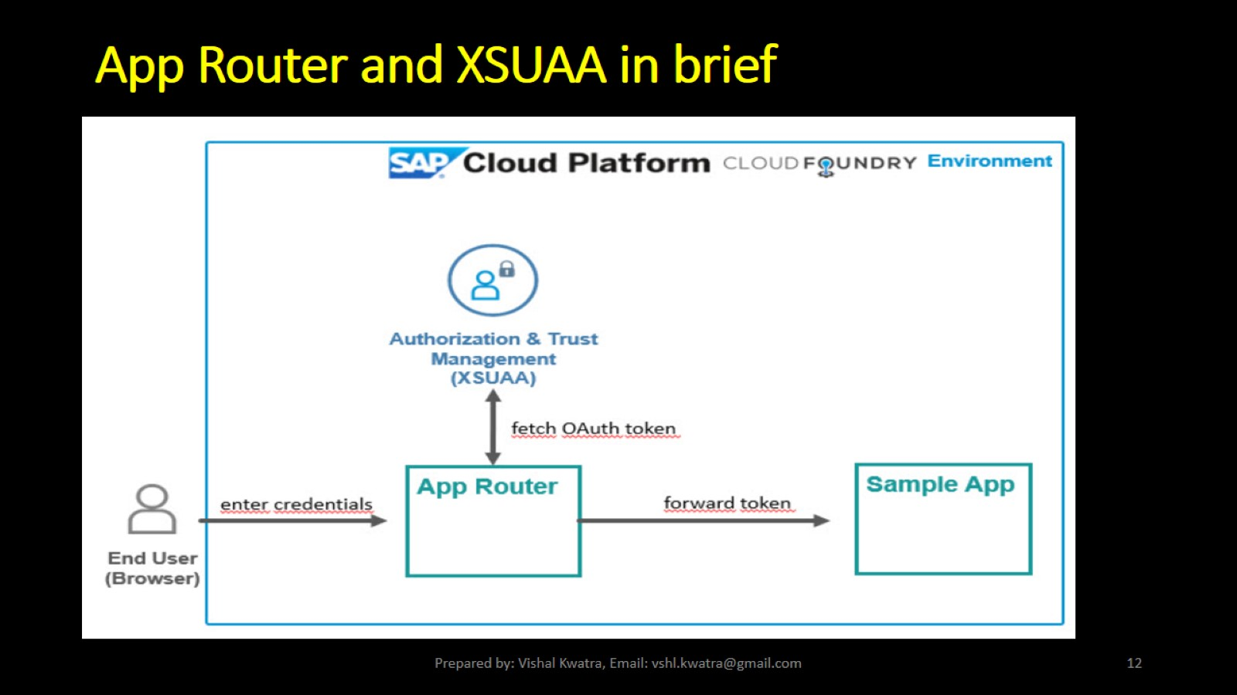
App Router and XSUAA in brief

Slide 13
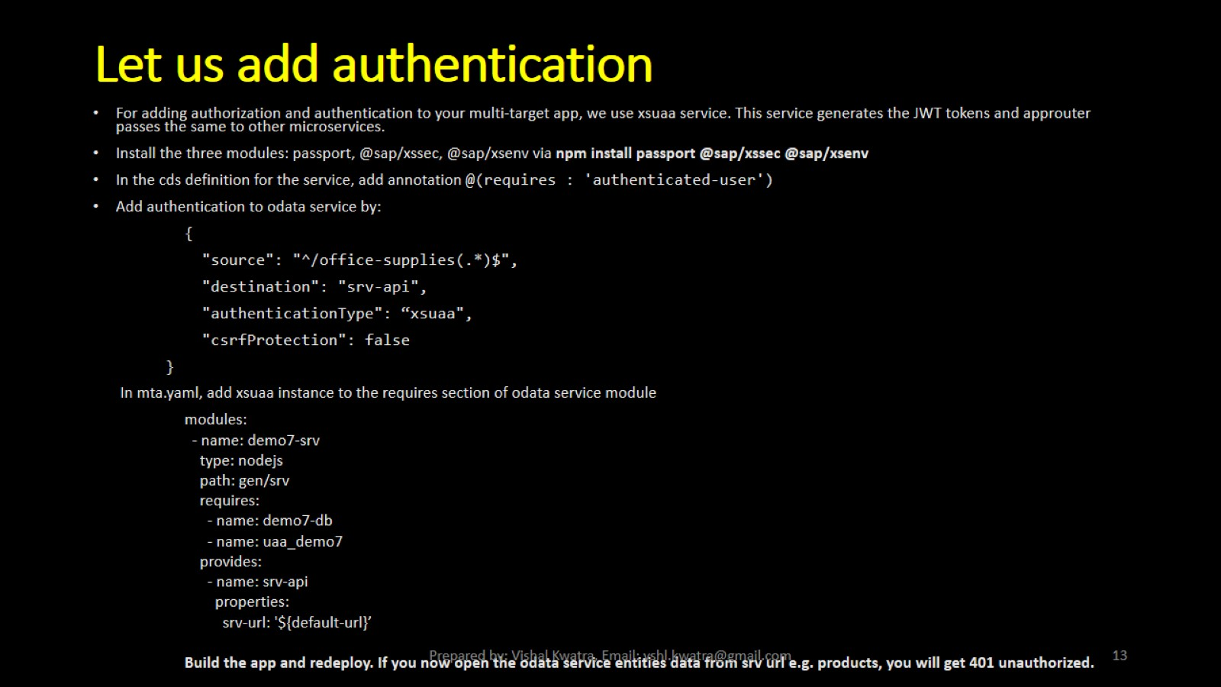
Let us add authentication

Slide 14
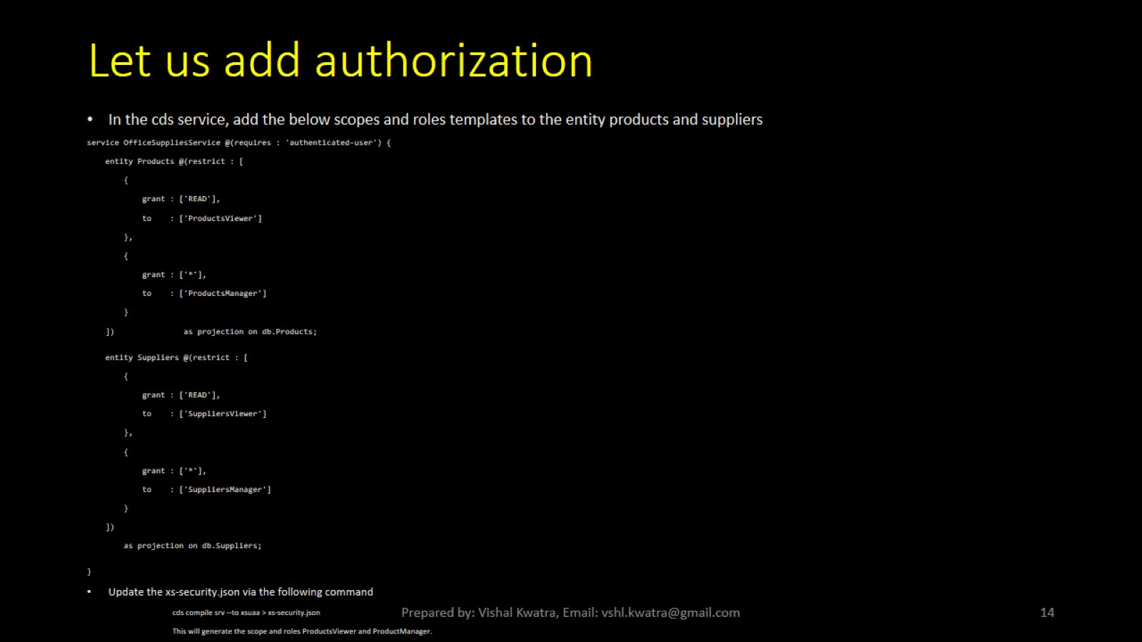
Let us add authorization

Slide 15
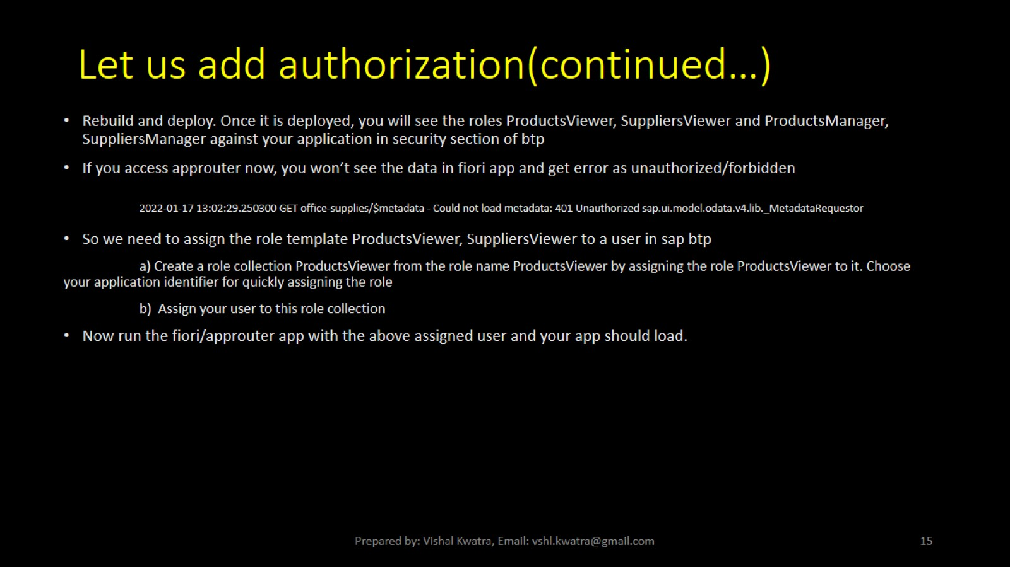
Let us add authorization(continued…)

